Slide 1
DIGITALIZATION AND PRODUCTION LOGISTICS AT ROBERT BOSCH POWER TOOL KFT.
LÁSZLÓ FÜKŐ
ROBERT BOSCH POWER TOOL KFT.
PLANT MANAGER

Slide 2
Table of contents
Digitalization in SupplyChain
Digital logistics ecosystem at Robert Bosch Power Tool Kft.
HFU
Just In Sequence (JIS)
Mobile SM
eKanban (Internal)
SPS
Traceability

Slide 3

Digitalization in Supply Chain
Production Logistics
Distribution
Customer
Supplier
EDI
RFID
eKanban
SAP-SupplyOn (Asian)
Local Cross Dock
JIS
HFU
SPS
eKanban
Mobile SM
Traceability
User registration

Slide 4

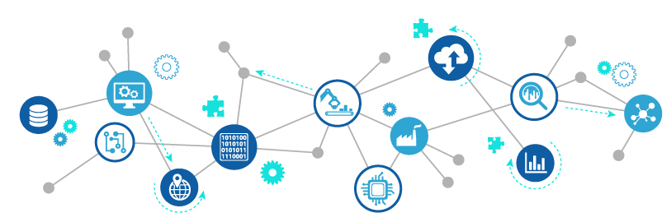


Digital logistics ecosystem at Robert Bosch Power Tool Kft.
Dashboard
visualization
Real-time data
Packaging system
Traceability
Productivity
Capacity level
eJIS
eKanban
eLeveling
eEscalation
KPI
Database
Estimated Shift Efficiency
Mobile SM
Estimated Production Start

Slide 5
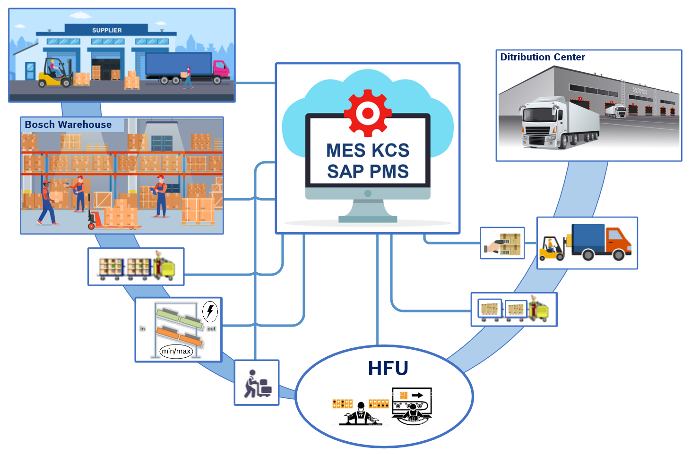
HFU

Slide 6
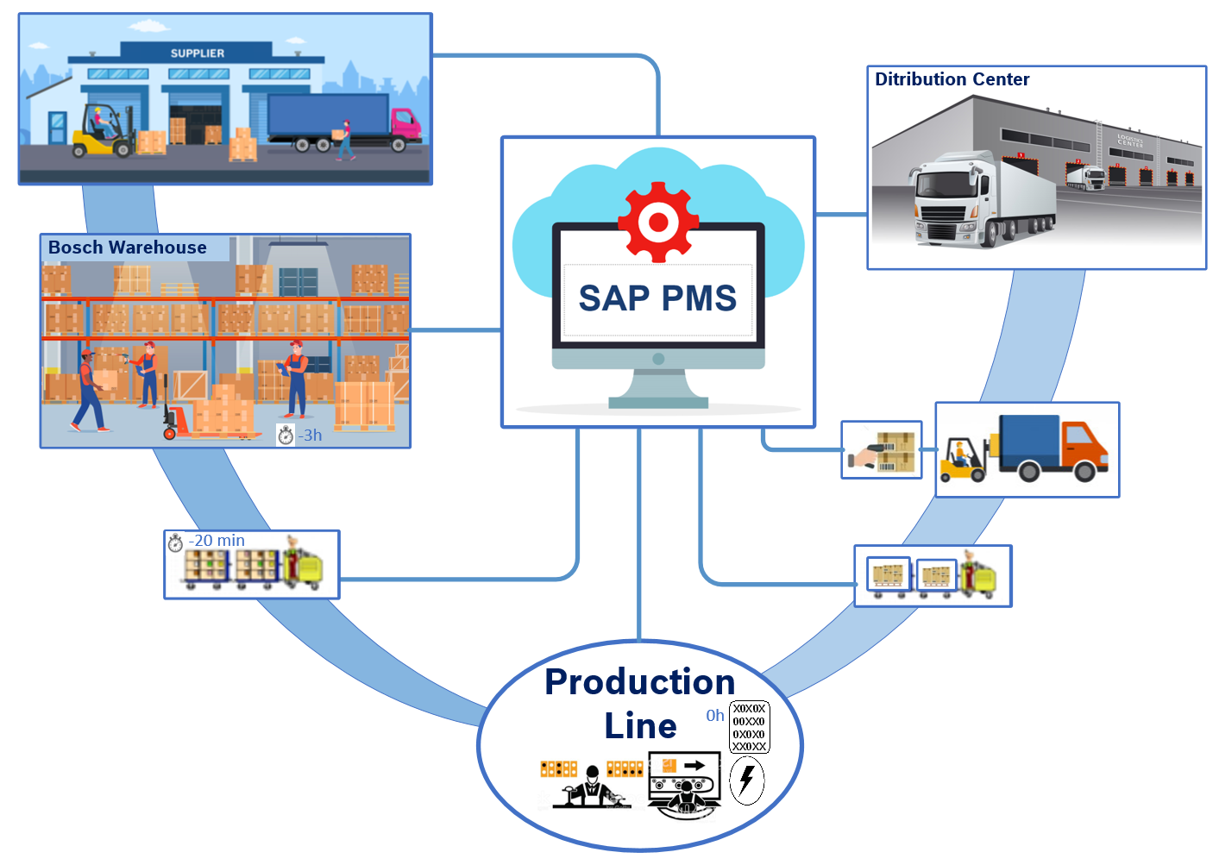
Just In Sequence (JIS)

Slide 7
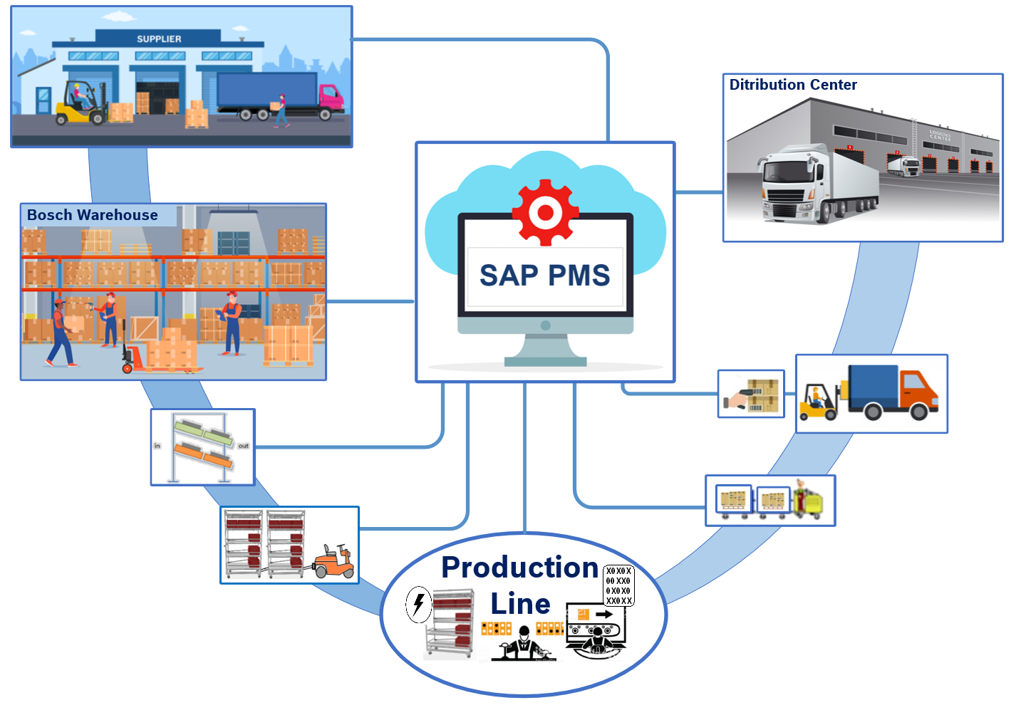
Mobile SM

Slide 8
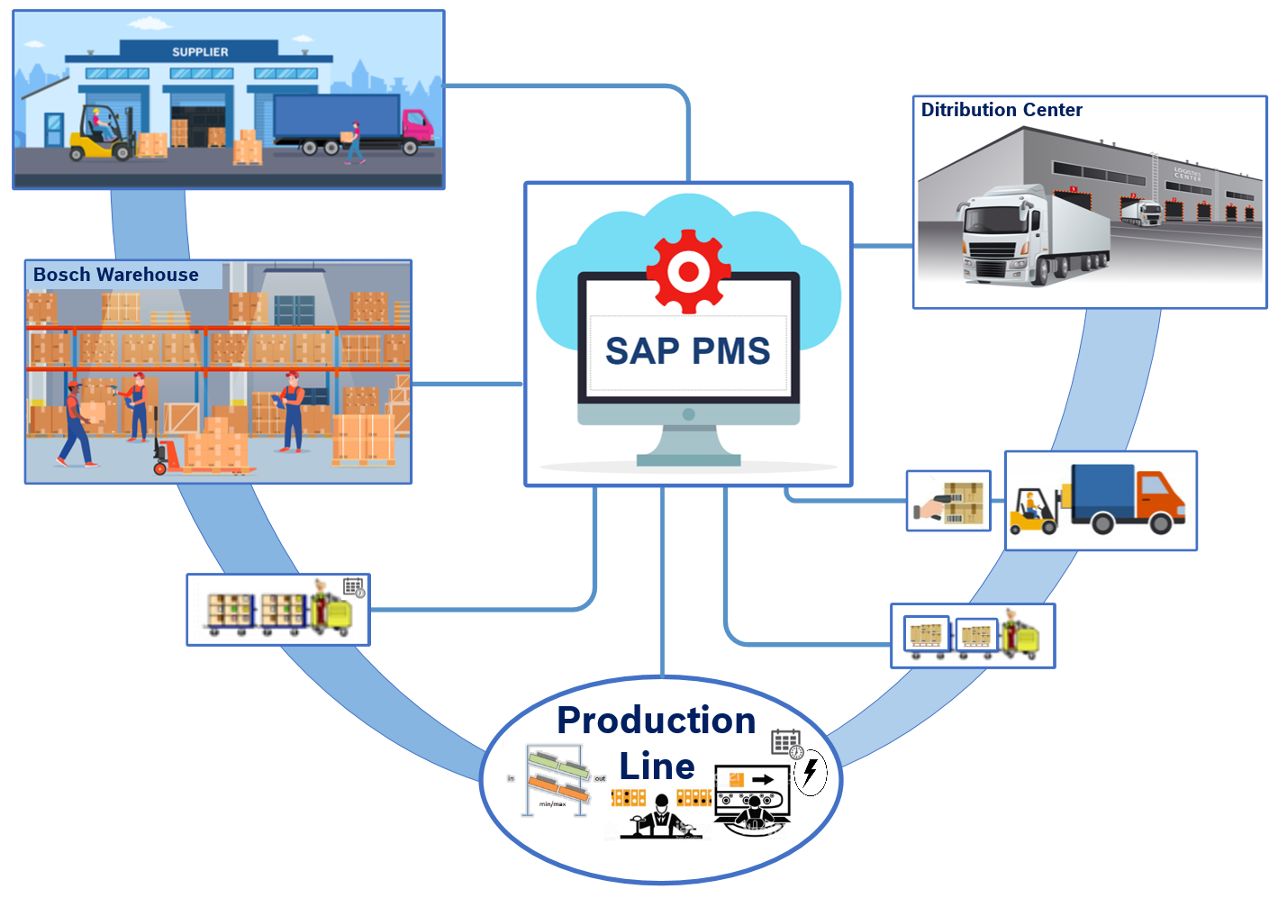
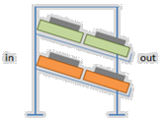
eKanban (Internal)

Slide 9
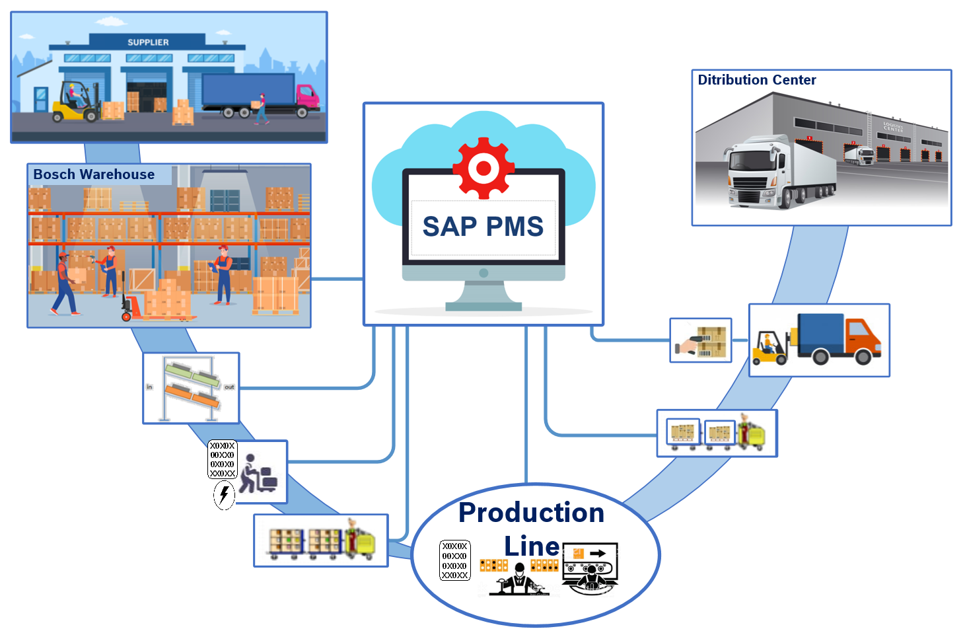
SPS

Slide 10
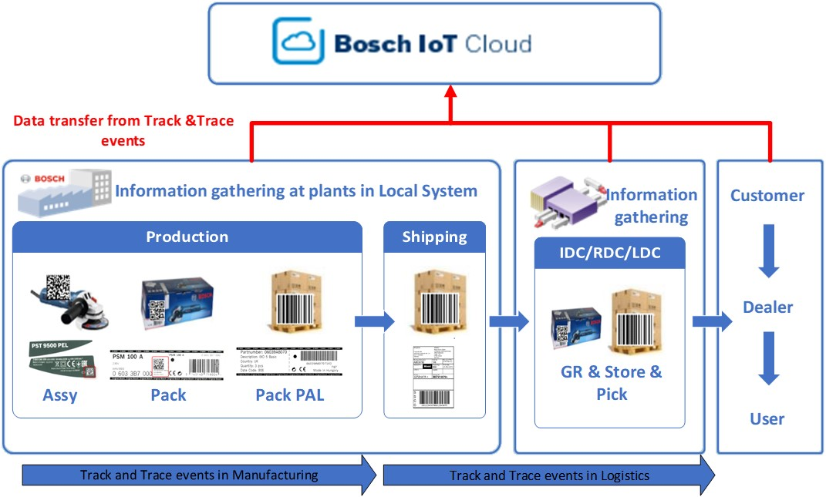
Product traceability

Slide 11
KÖSZÖNÖM A FIGYELMET!

